Slide 1

DIGIT & FACE CLASSIFICATION
Prathyusha Reddy Thumma
Kavya sri Kasarla
Bharath Chowdary Anumolu

Slide 2
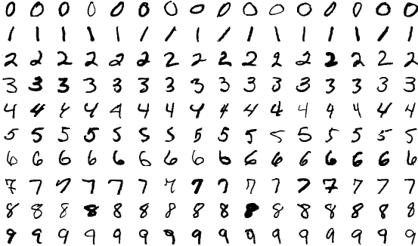
INTRODUCTION- DIGIT CLASSIFICATION
Digit classification(recognition) is used to identify the written digits, which can be used in fields such as: character recognition, OCR and image recognition.
Digit classification system is used to visualize artificial neural networks.

Slide 3

INTRODUCTION- FACE CLASSIFICATION
Face emotion classification is the ability to recognize measure various features and classify the face.
Emotions are reflected in voice, hand and body gestures and mainly through facial expressions.

Slide 4
PROPOSED METHODOLOGY
DIGIT CLASSIFICATION
Dataset Preparation
Dataset Pre-processing
‘CNN architecture design
Model Training
Model Tuning
Deployment
FACE CLASSIFICATION
Dataset preparation
Dataset Pre-processing (Image)
Facial feature extraction
CNN architecture design
Model training
Model Tuning
Facial expression detection
Deployment

Slide 5
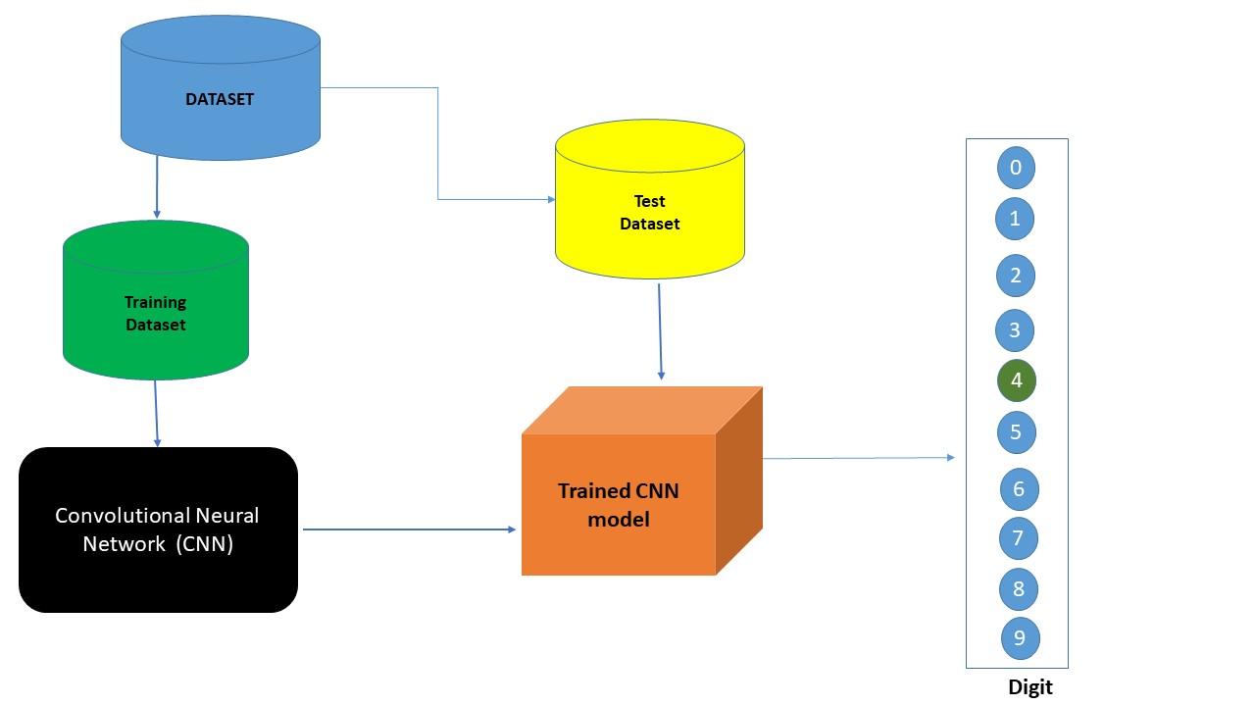
WORKING MODEL- DIGIT CLASSIFICATION
A CNN model consists of three primary layers:
Convolutional layer: Extracts high level input features from input data and passes those features to next layer
Pooling layer: Reduces the dimensions of data by applying pooling on the feature map
Fully-Connected layer: Probability scores are calculated for each class label by activation function called as “ SOFTMAX FUNCTION”

Slide 6
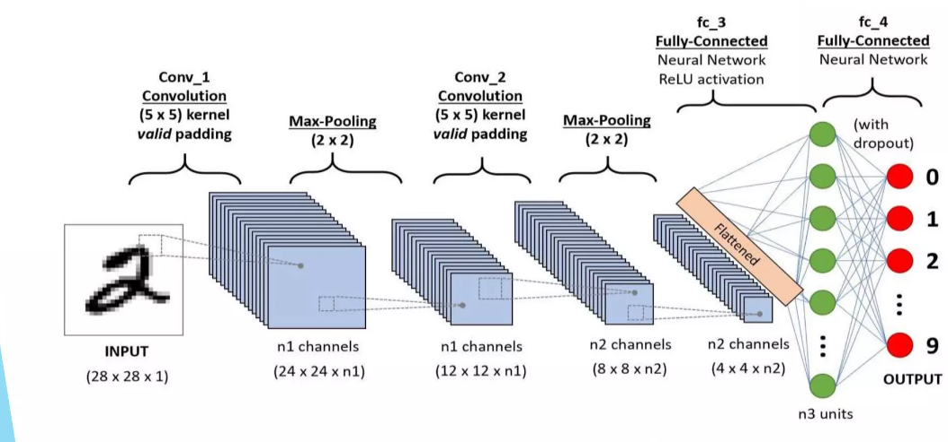

Slide 7
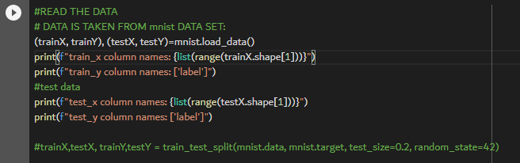
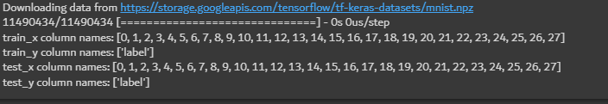
CODE SNIPPETS
Data preparation and pre-processing:

Slide 8
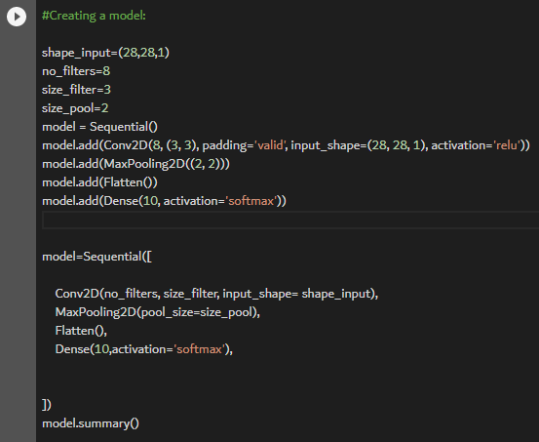
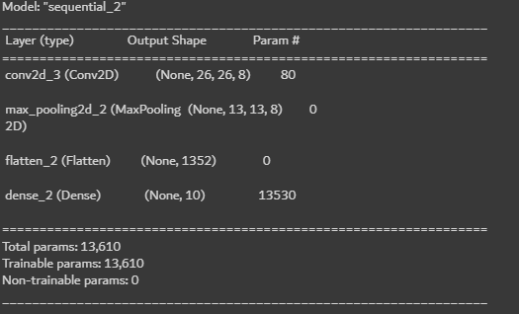
CODE SNIPPETS
Convolution CNN:

Slide 9
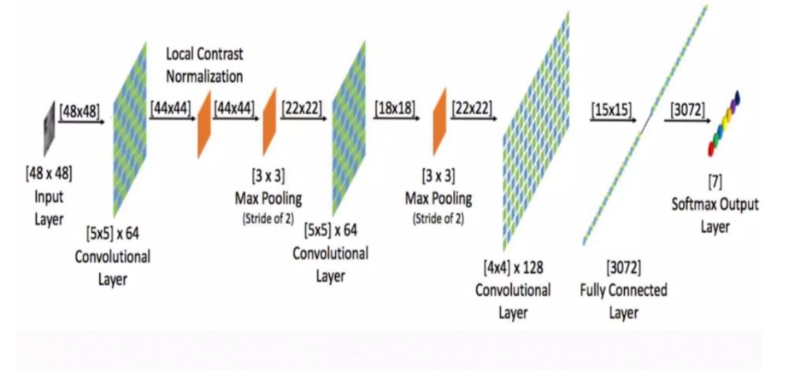
WORKING MODEL- FACE CLASSIFICATION
The proposed system is capable of performing automatic facial expression or emotion recognition
The approach integrates a module for automatic face detection, by generating neural network using training dataset.
A CNN model consists of three primary layers:
Convolutional layer: Extracts high level input features from input data and passes those features to next layer
Pooling layer: Reduces the dimensions of data by applying pooling on the feature map
Fully-Connected layer: Probability scores are calculated for each class label by activation function called as “ SOFTMAX FUNCTION”

Slide 10
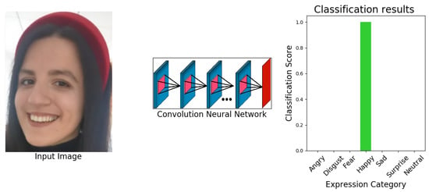

Slide 11
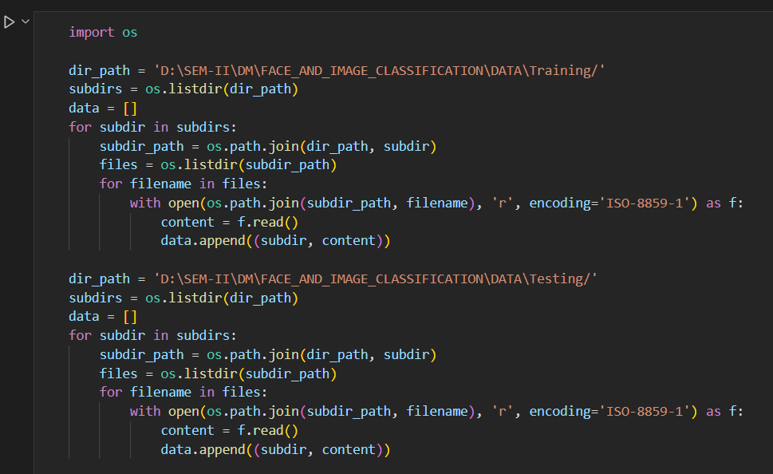
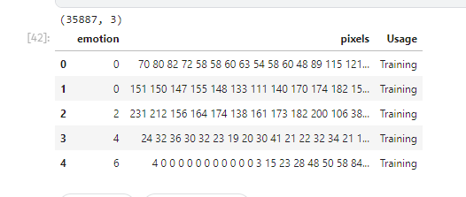
CODE SNIPPETS
Data preparation and pre-processing:

Slide 12

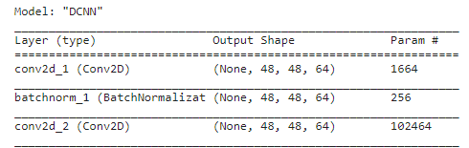
CODE SNIPPETS
Deep CNN:

Slide 13
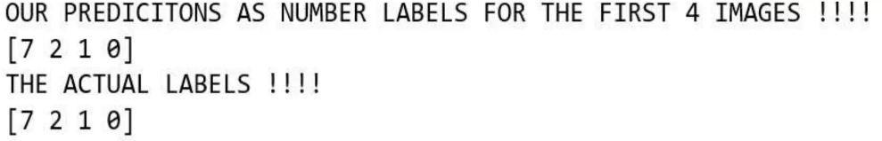
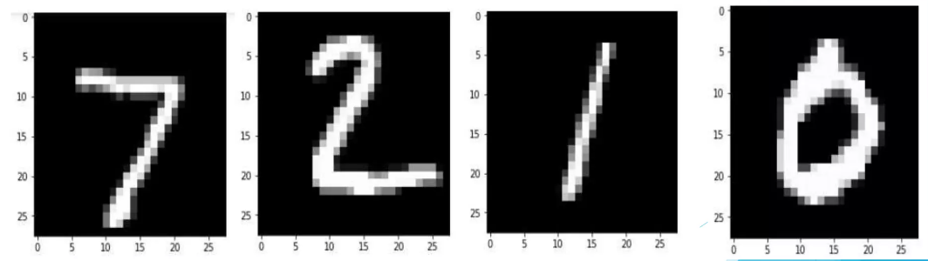
RESULTS

Slide 14
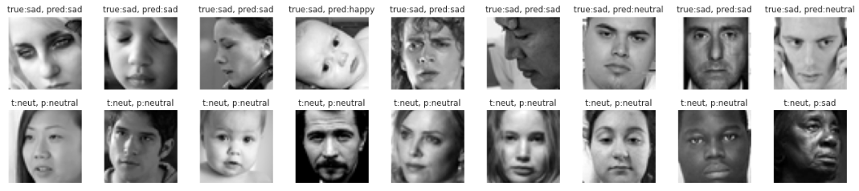
RESULTS.. contd

Slide 15
APPLICATIONS
Face classification system
E-Learning system
Robotics system
Human-Computer interaction system
Digit classification system
Used in visualizing artificial neural networks
Processing bank cheques
Identifying postal addresses

Slide 16
CONCLUSION
Digit recognition using CNN has proved to be an efficient method to solve existing problems
It works better than other algorithms.
Face classification using CNNs has shown great promise in accurately identifying individuals from images.
Face classification using CNNs is a rapidly advancing field with a wide range of applications, from security and surveillance to social media and entertainment

Slide 17


